Slide 1
Photomicrographs of Plant foods
Bean: Lima
Permission to reproduce original photomicrographs used to make this collection may be obtained from
Dr. David O. Norris at
david.norris@colorado.edu

Slide 2
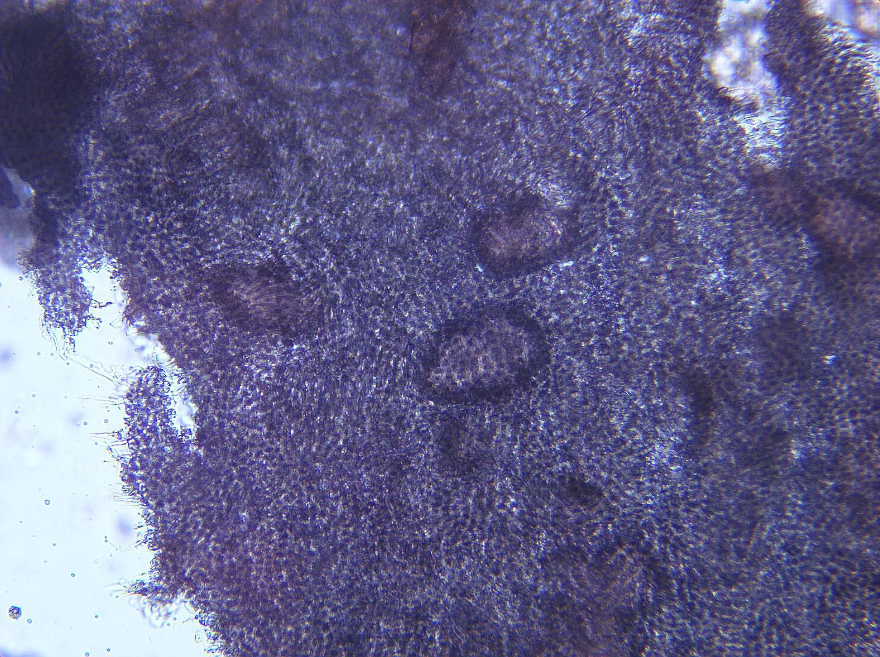
Notes:
64. Phaseolus lunatus L. Bean, lima. Seed coat (testa), 10X.

Slide 3
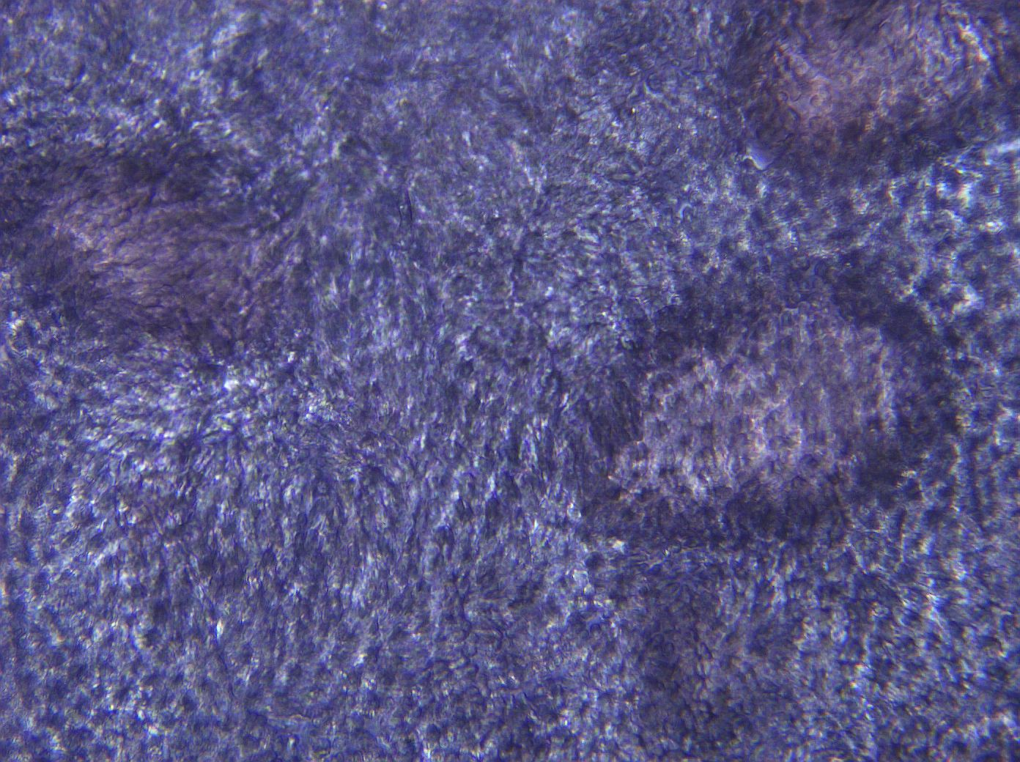
Notes:
65. Bean, lima. Seed coat, 25X.

Slide 4
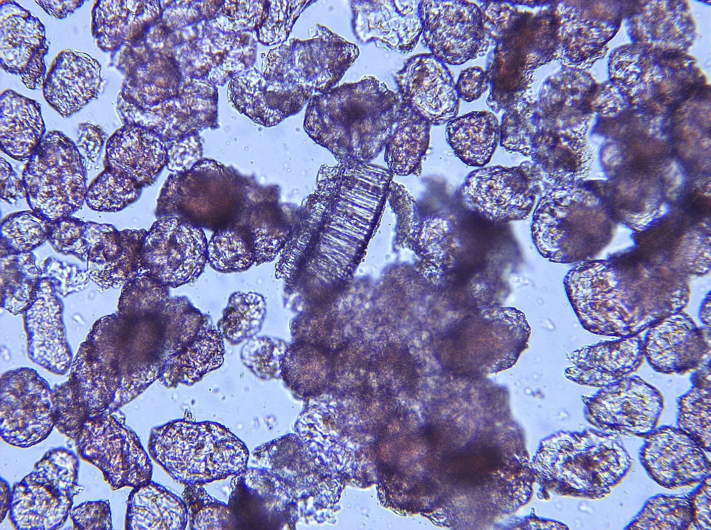
Notes:
66. Bean, lima. Pulp parenchymal cells, 10X.

Slide 5
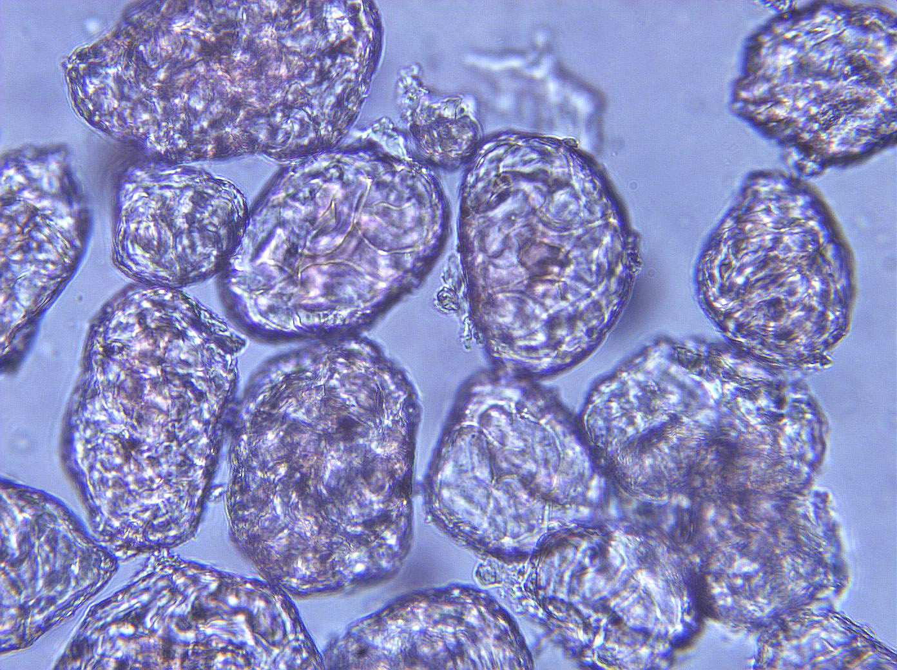
Notes:
67. Bean, lima. Pulp parenchymal cells, 25X.

